Slide 1
Research Seminar 1 Literature Research Carlos Nuno Castel-Branco Visiting Full Professor cnbranco@iseg.ulisboa.pt | carlos.castelbranco@gmail.com 13-10-2023
PhD Development Studies of the University of Lisbon

Slide 2
Activities of today
What is a literature review
Aims of the literature review
Setting the field of study
Setting the specific research question
Exploring the research question
Setting the methodology
Adding to knowledge
How to set the parameters of the literature review
Online sources of literature

Slide 3
What is a literature review?
A literature review is a critical survey and analysis of published, scholarly sources (such as books, journal articles, and theses) on a particular topic. It gives an overview of key findings, concepts and developments in relation to a research problem or question, provides an assessment, classification, comparison and evaluation. A good literature review doesn’t just summarize sources—it aims to:
Analyse, interpret and critically evaluate the literature
Synthesise sources to highlight patterns, themes, conflicts, and gaps
Show the state of current knowledge in relation to a central research question or hypothesis
Not for its own sake, but to explore critically and professionally a field of knowledge and build the tools and path for specific research

Slide 4
Aims of the literature review
Setting the field of study:
Field of study within which your work will be undertaken has to be known to full professional level (meaning that you can discuss and contribute to it in ways the professionals will want to listen to what you have to say)
Setting the specific research question:
What it is, how/where to locate it, why is it relevant to understanding a specific problem in your field of study and to adding to existing body of knowledge
Exploring the research question:
What is known, gaps/tensions/contradictions, what your thesis needs to to

Slide 5
Aims of the literature review
Setting the methodology:
Working theory/concepts/model, justification of an approach, demonstration that your “apparatus” is adequate and sensitive enough to capture what you want to capture, the selection, treatment and interpretation of the data and its adequacy to support your thesis.
Methodology versus activities + technique (the last two are subordinated parts of the first)
Exploring the methodologies utilised in research in your field and in the specific are of your question. Are you adopting one or creating a new one? Why
Adding to knowledge – marking out a “thesis-shapped hole” in the research literature, which you are intending to fill:
Clearly setting in which way your thesis adds to existing knowledge or changes it – your conclusions

Slide 6
How to set the parameters of the literature review?
Dialectic combination between knowing the key literature, focus and knowledge about the specific topic – these different elements “discipline” each other:
No escaping from the need to know the broad, key debates.
Good summaries for yourself: common and different issues, how they are approached, tensions and contradictions, methodologies, case studies, limitations, key readings
What, how, why this relates to your own research – supports, need to build from (develop), questionable/not applicable, need to reject

Slide 7
How to set the parameters of the literature review?
Need of “research pegs”:
Points of reference around which you select readings and you search the readings.
Attention: you are reading in search of something, otherwise you will never finish, understand, find
These “pegs” provide the structure of the final critical literature review
Attention: your summaries of the literature for yourself are not the final critical literature review of your thesis
Your literature review feeds your thesis:
Thesis-shaped hole to be filled; bridging a gap in knowledge of what a well-educated, professional scholar in your field knows and what they need to know to read the remainder of your thesis, what books and articles they would need to read in order to do so; not a general discussion but one that points forward to your original contribution; show/point out to why your arguments in the thesis are important

Slide 8
How to set the parameters of the literature review?
Read critical/key literature reviews in your field
Explore networks of scholars in your field and topic – to know who is doing what, the main schools of thought, key readings. Be aware of the danger of mainstream, orthodoxies and theoretically week/flawed eclecticism. Be aware of buzz wording, which are substitutes to proper concepts and theory
Get professional help.

Slide 9
Free, online sources of books and articles
First and foremost, there are the library sources at ISEG and other academic resources (like J-stor, for example), with which ISEG and other Univ of Lisbon libraries are connected. Go to ISEG’s library, get familiar with the system (ask for help, if necessary).
Large variety of sites which offer free access to books and articles: example, https://b-ok.org/ , and https://1lib.eu/?regionChanged=&redirect=10264732 . There are many other sources.

Slide 10
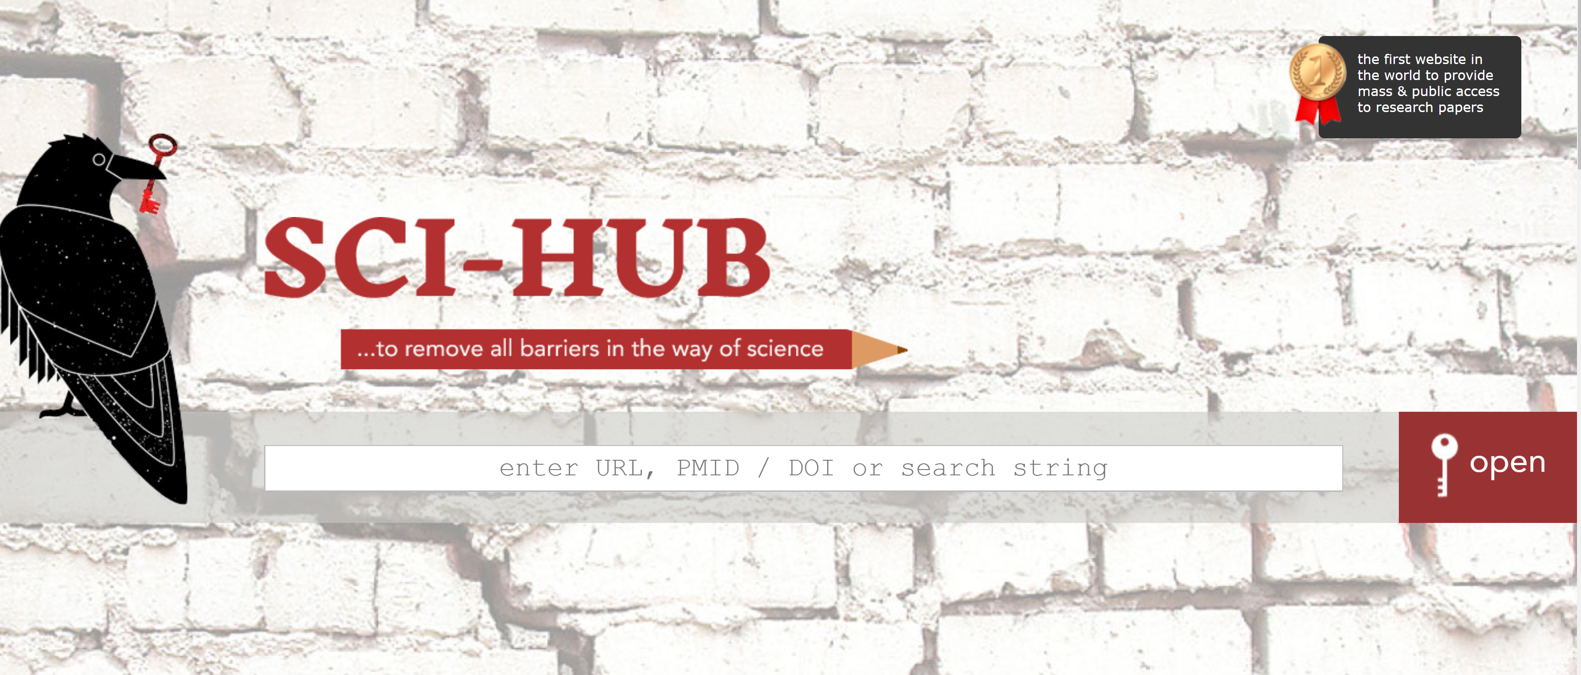
Free, online sources of books and articles
https://sci-hub.se/. This site is not mainstream (sometimes considered illegal), so that it is often caught and closed. Just look on the net for sci-hub and get the new site. What you have to do is to get the DOI, URL, etc., of a paper, type/paste it in, and get your paper (> 90% of the papers found)

